Slide 1

Project Report on
HOUSING: PRICE PREDICTION
Submitted by: Purnima Pati

Slide 2
Introduction and problem statement
Houses are one of the necessary need of each and every person around the globe and therefore housing and real estate market is one of the markets which is one of the major contributors in the world’s economy. It is a very large market and there are various companies working in the domain. Data science comes as a very important tool to solve problems in the domain to help the companies increase their overall revenue, profits, improving their marketing strategies and focusing on changing trends in house sales and purchases. Predictive modelling, Market mix modelling, recommendation systems are some of the machine learning techniques used for achieving the business goals for housing companies. Our problem is related to one such housing company.
A US-based housing company named Surprise Housing has decided to enter the Australian market. The company uses data analytics to purchase houses at a price below their actual values and flip them at a higher price. For the same purpose, the company has collected a data set from the sale of houses in Australia. The data is provided in the CSV file below.
The company is looking at prospective properties to buy houses to enter the market. You are required to build a model using Machine Learning in order to predict the actual value of the prospective properties and decide whether to invest in them or not. For this company wants to know:
• Which variables are important to predict the price of variable?
• How do these variables describe the price of the house?

Slide 3
We are required to model the price of houses with the available independent variables. This model will then be used by the management to understand how exactly the prices vary with the variables. They can accordingly manipulate the strategy of the firm and concentrate on areas that will yield high returns. Further, the model will be a good way for the management to understand the pricing dynamics of a new market
Problem Statement: We need to build a regression model using regularisation in order to predict the actual value of the prospective properties and guide the company in making the best decision.

Slide 4
Let’s look at the need of house price prediction
House price forecasting is an important topic of real estate. The literature attempts to derive useful knowledge from historical data of property markets. Machine learning techniques are applied to analyze historical property transactions in India to discoveruseful models for house buyers and sellers. Revealed is the high discrepancy between house prices in the most expensive and most affordable suburbs in the city. Moreover, experiments demonstrate that the Multiple Linear Regression that is based on mean squared error measurement is a competitive approach
Property valuation is an imprecise science. Individual appraisers and valuers bring their own experience, metrics and skills to a job. Consistency is difficult, with UK and Australian-based studies suggesting valuations between two professionals can differ by up to 40%. Crikey!
Perhaps a well-trained machine could perform this task in place of a human, with greater consistency and accuracy.

Slide 5
EDA / Data Cleaning
Exploratory data analysis (EDA) helps us understand the data and provides ideas and insights for data cleaning and feature engineering. Data cleaning prepares the data for our algorithms while feature engineering is the magic sauce that will really help our algorithms draw out the underlying patterns from the dataset.
Let's start with the distribution of the target variable, sales price. There is a clear right-skew in the distribution of sale price with a vast majority of property values in the $100,000 — $200,000 range, but with a long tail stretching upward towards $800,000 (bottom left image). Using a Box-Cox transformation, we identified that taking the log of sale price transforms the distribution to approximately normal (bottom right image). This transformation increased the strength of linearity amongst most of our variables against sale price, validating the assumption of linearity in regression.

Slide 6
EDA / Data Cleaning continue…..
Multi-Variable Analysis:
There are two types of features namely numerical and categorical.
The categorical data is either ‘Yes’ and ‘No’,’Fare’ and ‘Near’
The numerical data in numerical form. These features are in a linear relationship with each other. For example, a 2,000 square foot place is 2 times “bigger” than a 1,000 square foot place.
We also check the correlation of our dataset to check the correlation of the columns with each other. If columns are highly correlated with each other let’s say 90% or above then remove those columns to avoid multi coli-nearity problem.

Slide 7
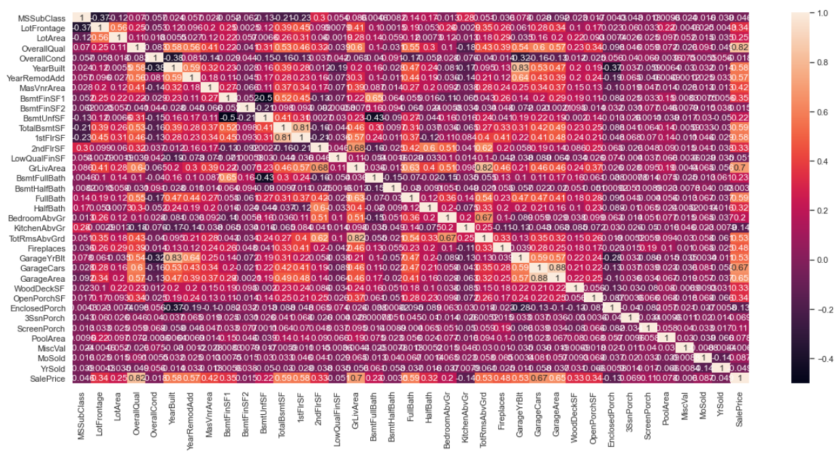
Correlation Matrix :Top 50% Corralation train attributes with sale-price

Slide 8
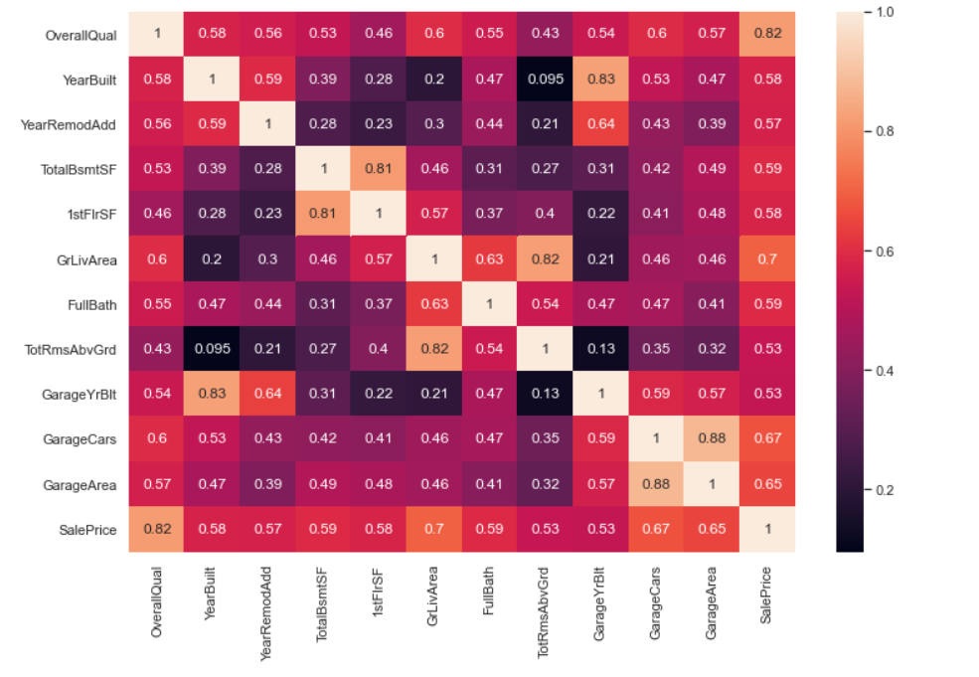
Here Overall Qual is highly correlated with target feature of sale price by 82%**

Slide 9
We have to deal with missing values before we can move further. If the number of rows with missing values is small enough, we can just drop them and move on. Let's see how many such rows exist
We have to know the reason behind the missing values, instead of dropping the rows blindly less us proceed in convicting the column so that the missing data process is not biased and hiding an inconvenient truth.

Slide 10
Modelling part
Regression Model
Linear Regression is a machine learning algorithm based on supervised learning.
It performs a regression task. Regression models a target prediction value based on
independent variables.
It is mostly used for finding out the relationship between variables and forecasting.
Random Forest Regression Model
A Random Forest is an ensemble technique capable of performing both regression and
classification tasks with the use of multiple decision trees and a technique
called Bootstrap Aggregation, commonly known as bagging.
Bagging, in the Random Forest method, involves training each decision tree on a
different data sample where sampling is done with replacement.
The basic idea behind this is to combine multiple decision trees in determining the
final output rather than relying on individual decision trees.
Gradient boosting
Gradient boosting is a machine learning technique used in regression and classification tasks, among others. It gives a prediction model in the form of an ensemble of weak prediction models, which are typically decision trees.

Slide 11
Accuracy --> 89.04002619286328
In [ ]:
Conclusion
So, our Aim is achieved as we have successfully ticked all our parameters as mentioned in our Aim Column. It is seen that circle rate is the most effective attribute in predicting the house price and that the GradientBoosting Regressor
is the most effective model for our Dataset with accuracy score 89.04002619286328

